Slide 1
LEOPARD MEETING
Anechoic Chamber Test
Ramson and Makiko
12/04/2023

Slide 2
Content
Anechoic chamber Test Results
Feasibility of having RF Switch for RF Test

Slide 3
Anechoic Chamber Test
Test setups
Antenna Test
UHF dipole antenna and S band (downlink and OPERA) patch antenna
Antenna calibration
Reflection coefficient/ antenna return loss test
S11
Transmission line impedance matching
Smith chart
Radiation pattern
E and H planes
Closed and open deployable solar panels
USRP SDR transceiver sensitivity test (work in progress)
Only for OPERA mission

Slide 4
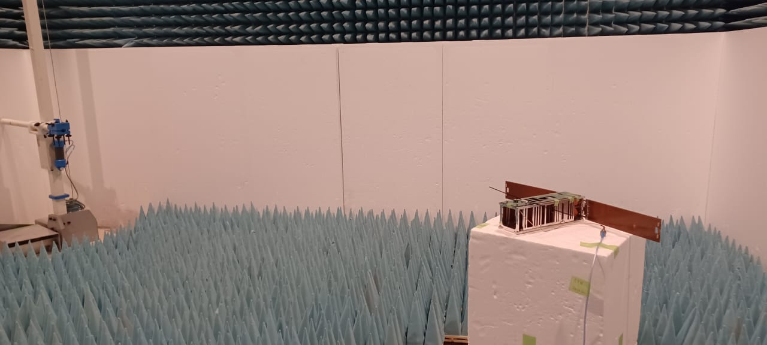
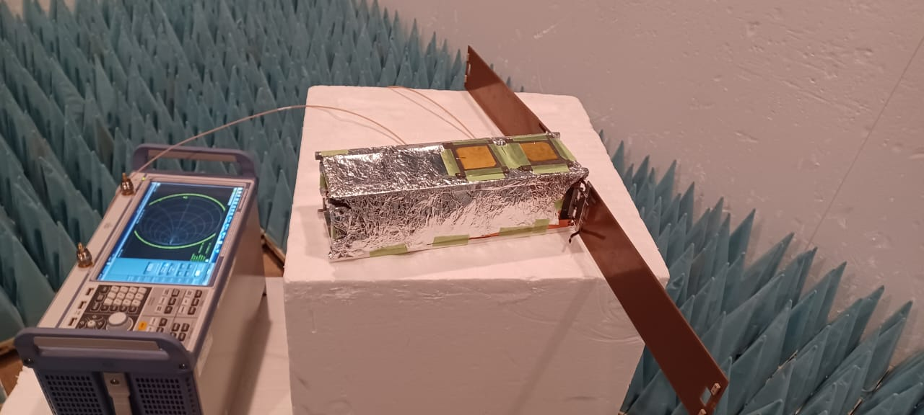
Reflection Coeff and Impedance Matching Setup
UHF Dipole Antenna
S-Band patch Antennas
RF Cable
Aluminium foil used to create infinite ground on Patch Antenna
RF cable
VNA
S11, Smith CHART

Slide 5
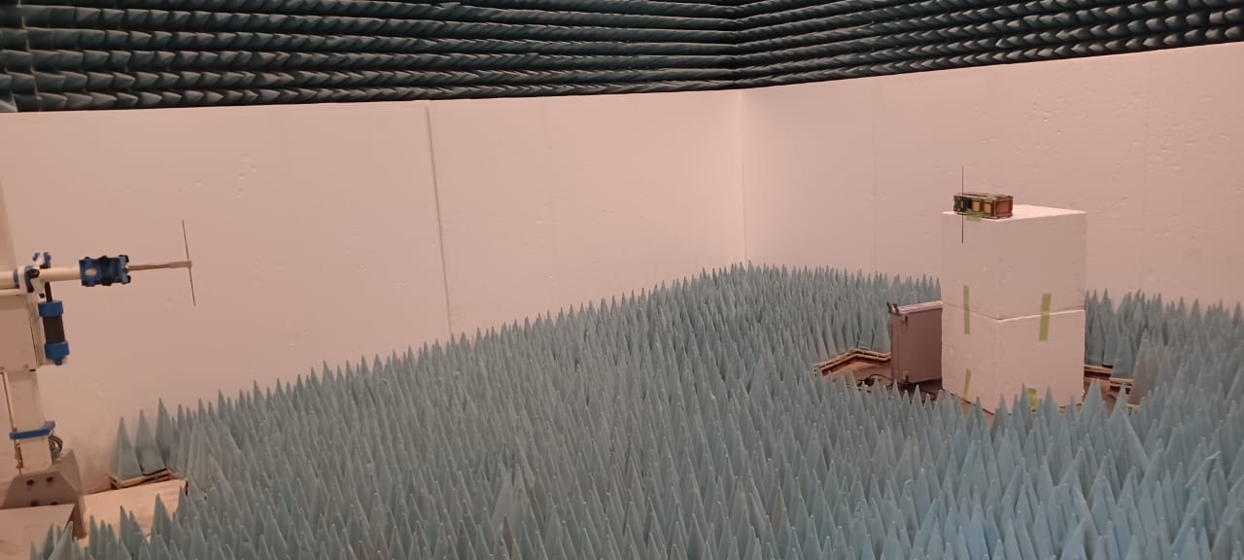
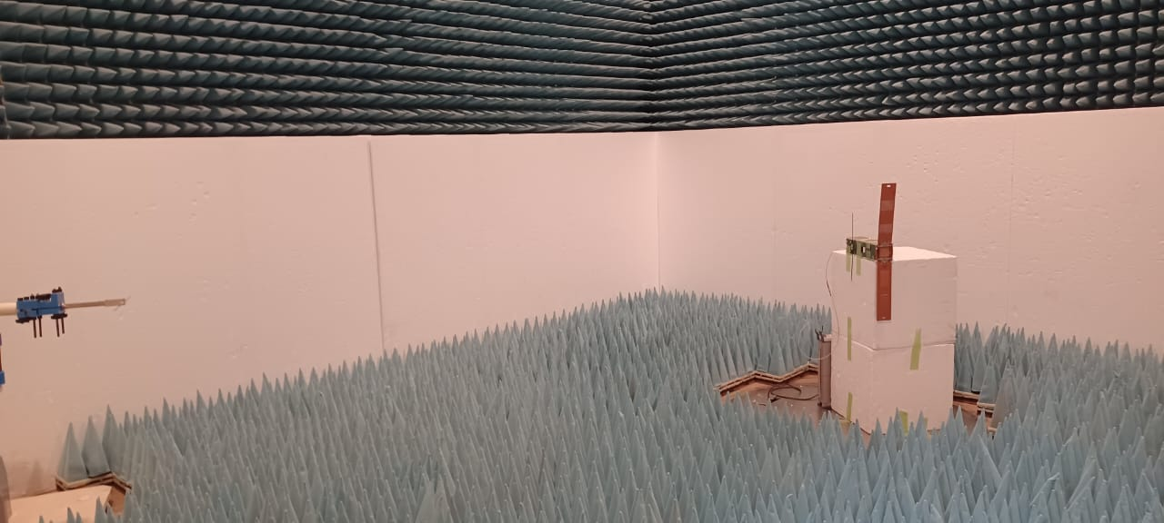
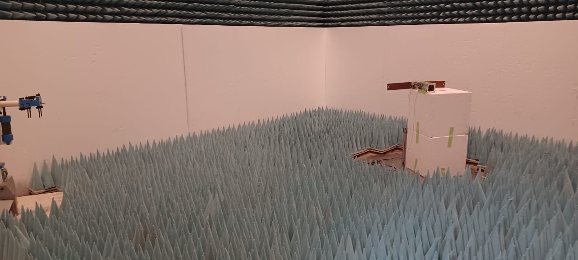
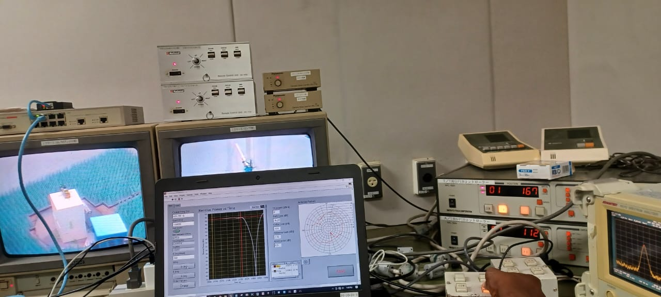
Radiation Test Setup
UHF E &H, undeployable solar panels
UHF E &H, deployed solar panels
Control room
S Band (downlink and OPERA), deployed solar panels

Slide 6
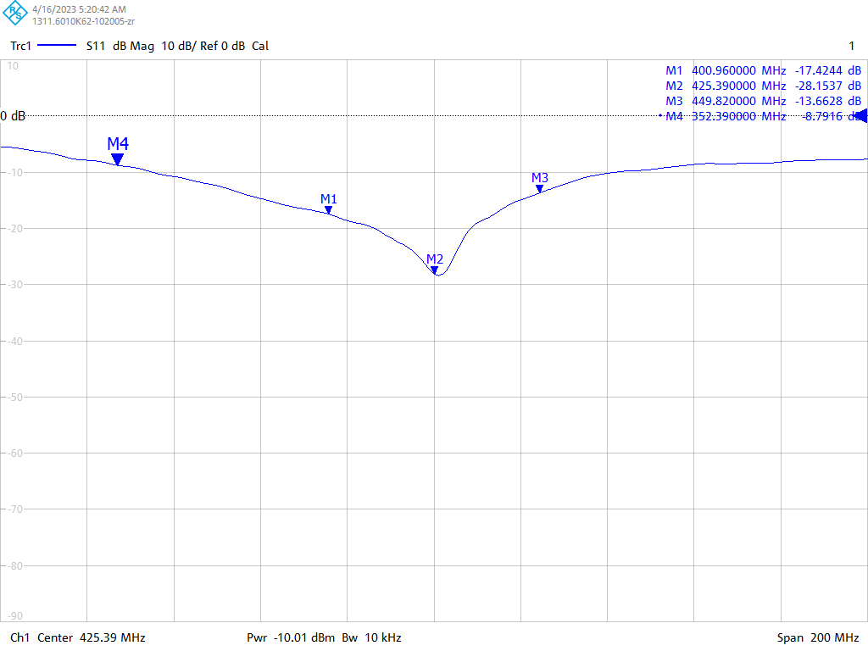
UHF Dipole Antenna S11 Parameters

Slide 7
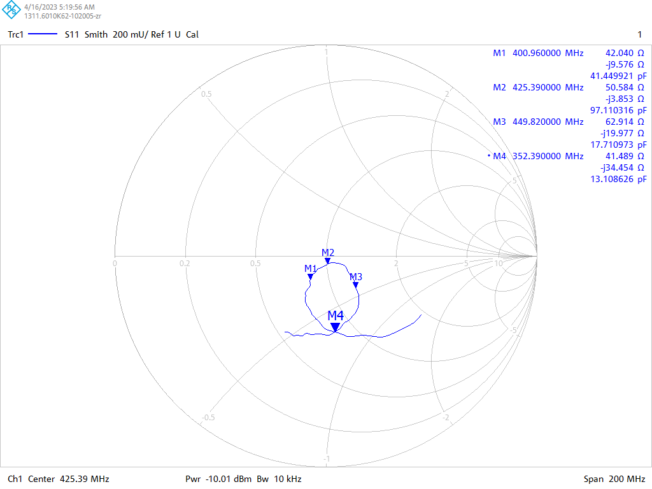
UHF Dipole Antenna Smith Chart

Slide 8
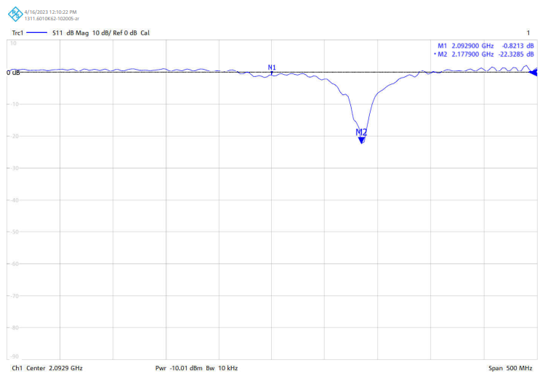
S Band OPERA Patch Antenna S11 Parameters

Slide 9
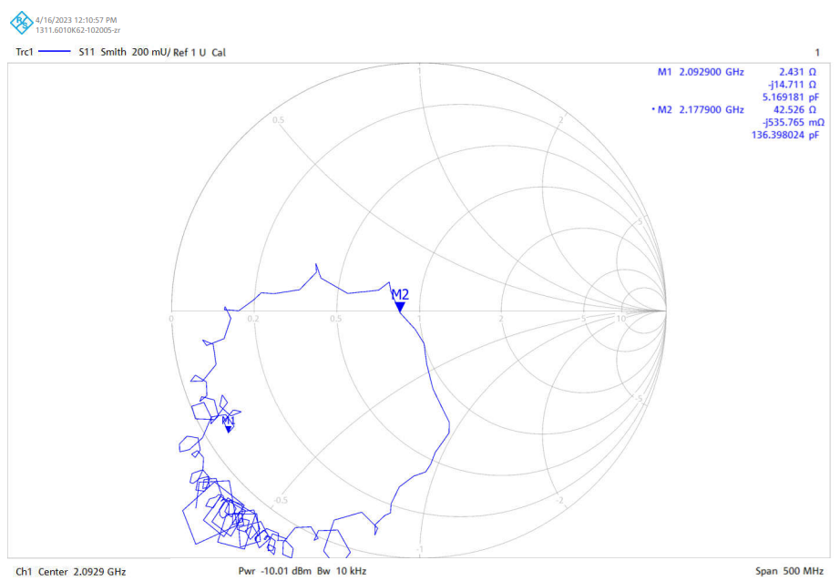
S Band OPERA Patch Antenna Smith Chart

Slide 10
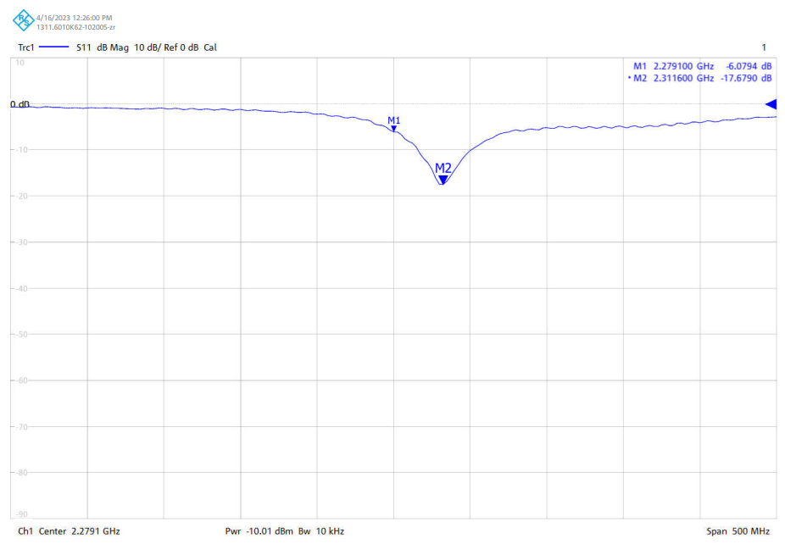
S Band Downlink Patch Antenna S11 Parameters

Slide 11
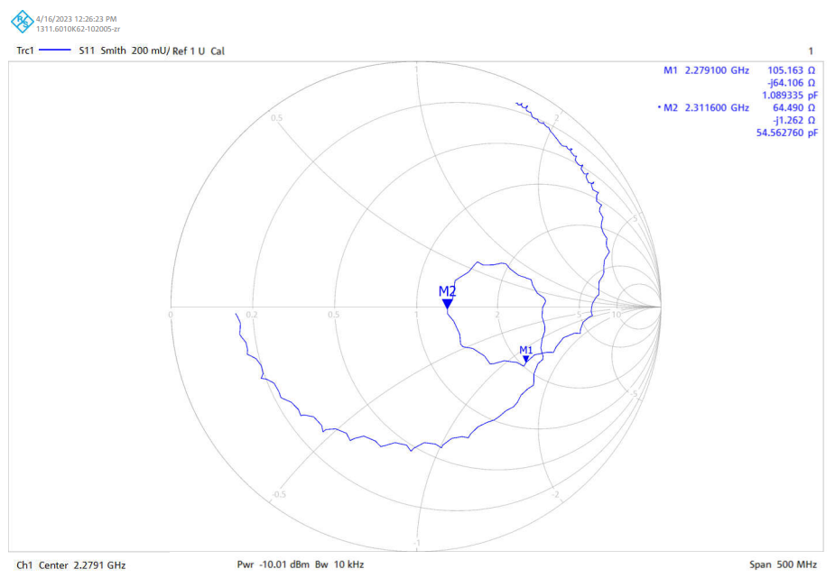
S Band Downlink Patch Antenna Smith Chart

Slide 12
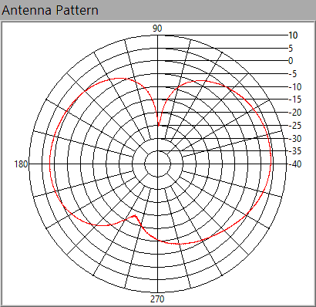
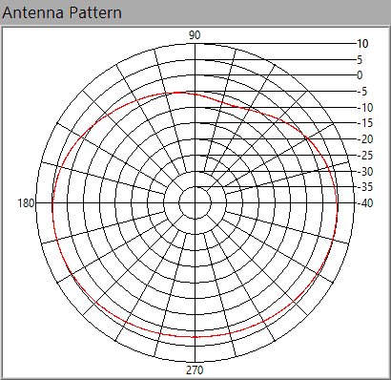
UHF Antenna Patterns: Open Deployable Solar Panels
E-Plane
H-Plane
max=4.16 dBi
max=4.94 dBi

Slide 13
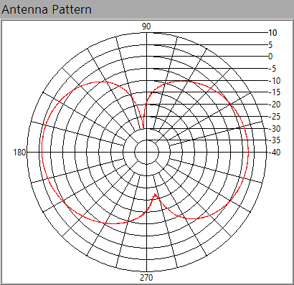
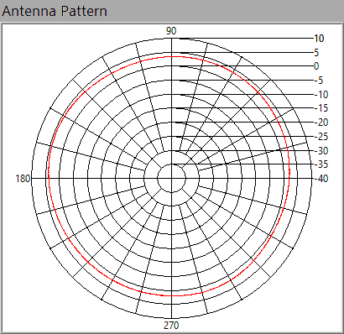
UHF Antenna Patterns: Closed Deployable Solar Panels
E-Plane
H-Plane
max=3.85 dBi
max=4.63 dBi

Slide 14
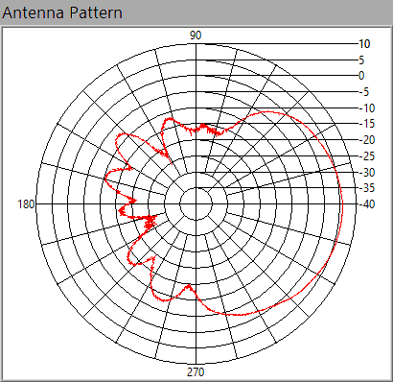
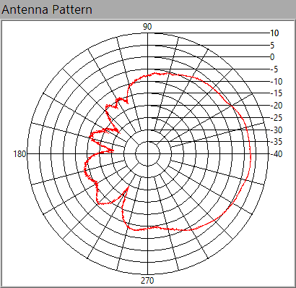
S Band Downlink Antenna Patterns: Open Deployable Solar Panels
-X Panel and GS Antenna H-plane
-X Panel and GS Antenna E-plane
max=5.89 dBi
max=5.55 dBi

Slide 15
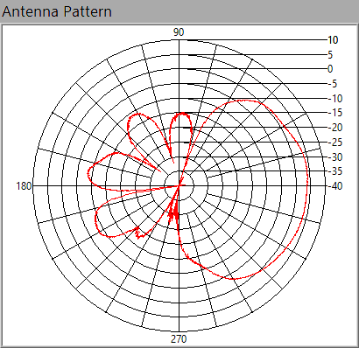
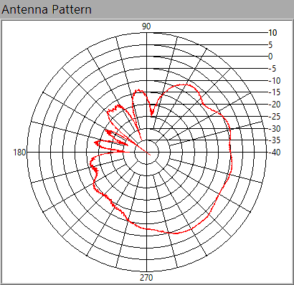
S Band OPERA Antenna Patterns: without LNA, Open Deployable Solar Panels
-X Panel and GS Antenna H-plane
-X Panel and GS Antenna E-plane
max=4.09 dBi
max=-2.76dBi

Slide 16
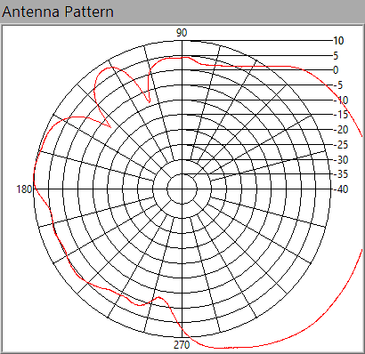
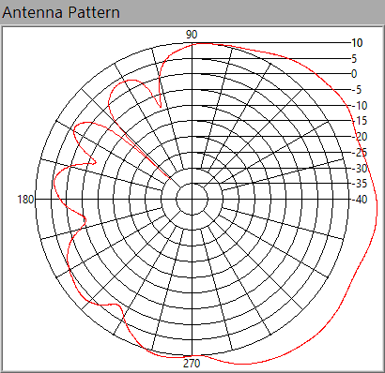
S Band OPERA Antenna Patterns: with LNA, Open Deployable Solar Panels
-X Panel and GS Antenna H-plane
-X Panel and GS Antenna E-plane
max=24.98 dBi
max=19.17 dBi
With LNA gain is high on different panel orientation of the S band patch antenna

Slide 17
Discussion
S band Patch Antennas (S11 and impedance is not good)
Very little signal is radiated much is reflected
Suggestion
Request for redesign of the antenna to the manufactures
Or to redesign our own antennas with the help of Dr Nakayama san (Patch antenna specialist)

Slide 18
Feasibility of having RF Switch for RF Test
We found another switch we use the principle of magnetic Relay
Nominal case no power is required
Still evaluating the switch in terms of size and functionality
To update next week
Waiting for confirmation from Cho Sensei on the RF switch used by Chiba University satellite

